Slide 2
Introduction
Ryan
Yiqiang
Maise
Nishan
Kunal
Santhosh

Slide 3
Pub Crawl
Overview

Slide 4
Route & Schedule Planning

Slide 5
What does our Route & Schedule Planner Do?
Say, you want to:
Start your pub crawl at Fort Point Beer Co. at 7 PM
Check out nearby breweries afterwards
Spend 40 min at each brewery sampling their offerings
Head home at 10 PM

Slide 6
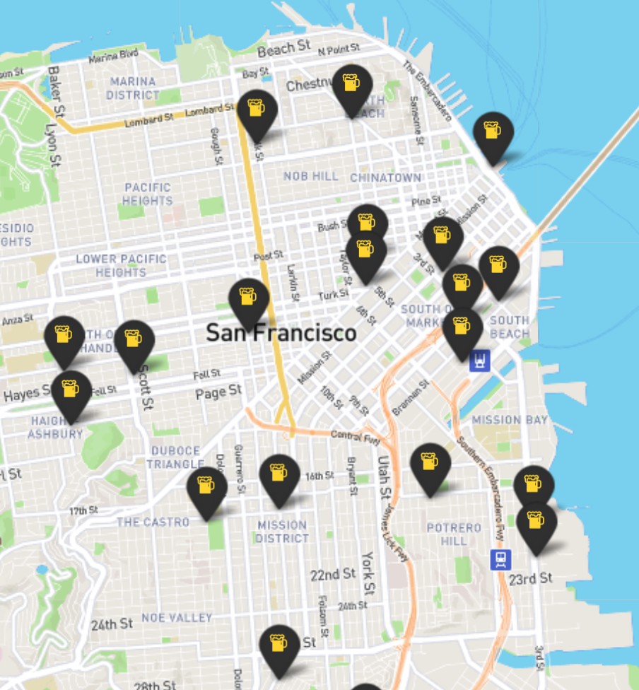
The Problem
Which breweries should you hit after Fort Point Beer Co.?
Several breweries nearby
Different operating hours

Slide 7
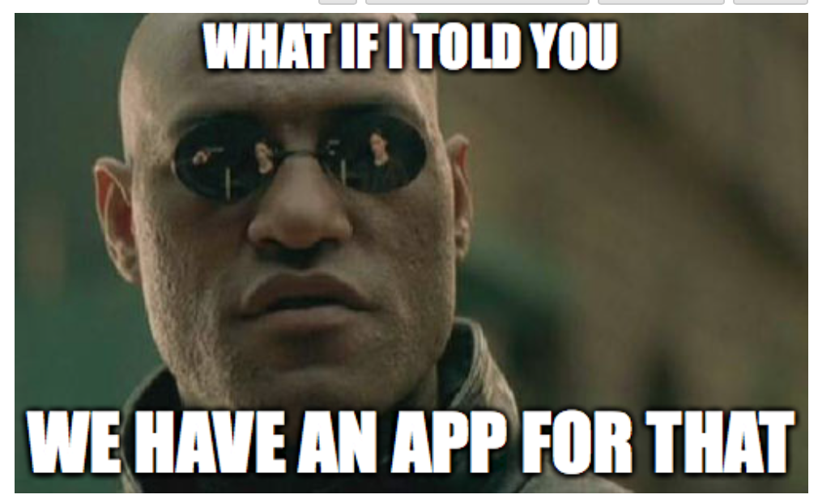
What Would an Awesome Route Plan Look Like?
Visiting as many breweries as possible
while
Keeping travel time as low as possible
while also
Visiting each brewery in the route while it’s open
and
Knowing when to move on to the next brewery

Slide 8
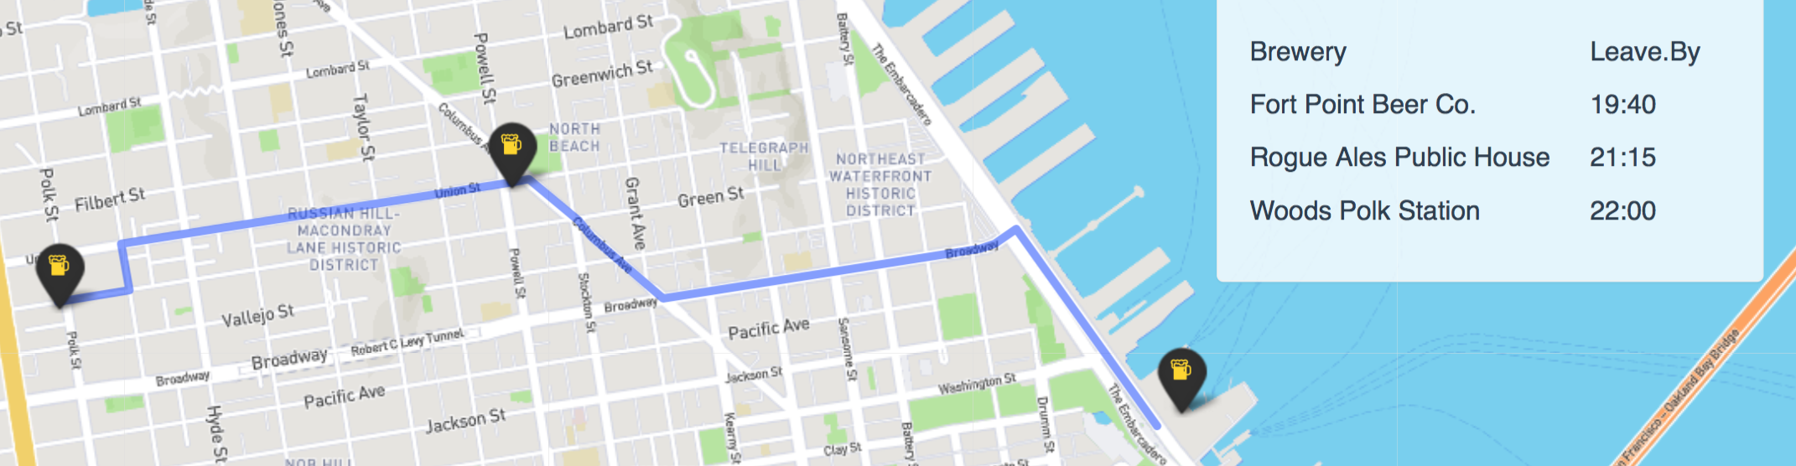
Route Plan & Schedule Example

Slide 9
Demo

Slide 10





Technologies

Slide 11
Modeling the Optimization Problem
Brewery
Start
Start
Don’t need to visit all nodes
But earn reward for each visited node
$
$
$
TSP
TSP with Profits

Slide 12
Modeling the Optimization Problem
Visit each node within specified time window
Vehicle Routing Problem with Time Windows
TSP with Profits
Implemented in Python using Google’s or-tools library
API for modeling and solving optimization problems

Slide 13
Insights

Slide 14
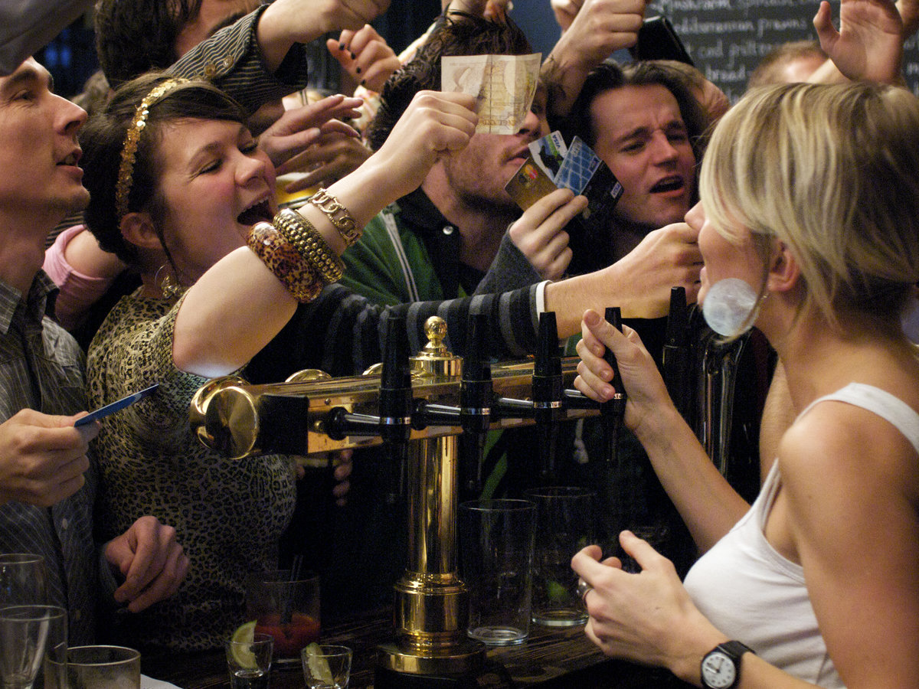
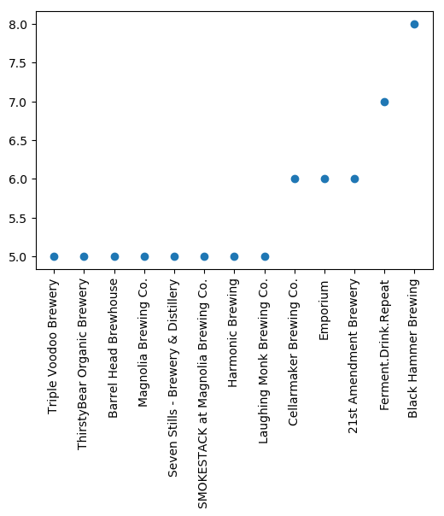
What it means for Breweries
Friday!!!
4 hour Pub crawl from 7 PM

Slide 15

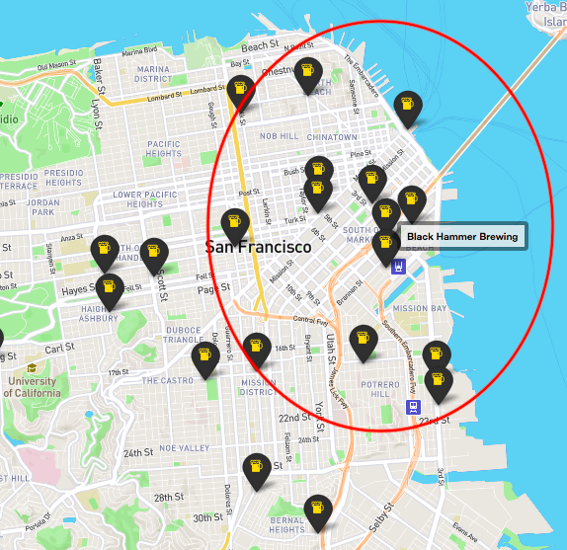
Black Hammer nailed it!

Slide 16

What made us drink
Changing menus
Different opening days and times
Data collection
Edge cases
Bringing together R front-end and Python route optimizer

Slide 17

What's Next
Mobile friendly version
Arbitrary starting locations
Choose mode of transport
Optimal route based on
waiting times at breweries
user feedback
live traffic data
Incorporate beer menus in brewery filtering

Slide 18

Thank you!

